Slide 1

Motilal Nehru National Institute of Technology, Allahabad Project on FRACTALS
Submitted by: Team 1
Submitted To: Prof. M.M. Gore Course: MCA I Semester
Subject: Programming and Problem Solving

Slide 2
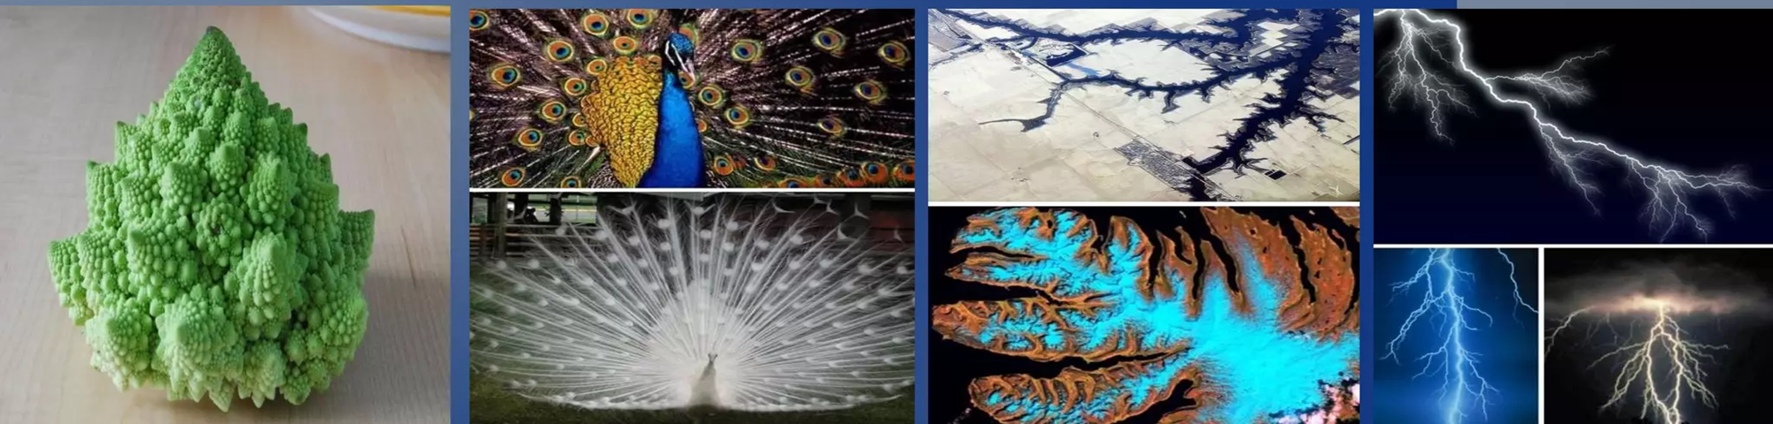
WHAT EXACTLY IS A FRACTALS ?
A fractal is a complex, never-ending pattern found in mathematics and nature that is created by repeating a simple process
Widely visible in nature: trees, clouds, lightning, galaxy patterns.
Computer-generated fractals rely on complex numbers and recursion.
In this project, we implemented Mandelbrot, Burning Ship Set, and Tricorn fractals using C programming.

Slide 3

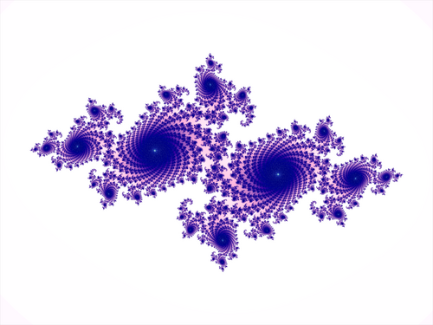
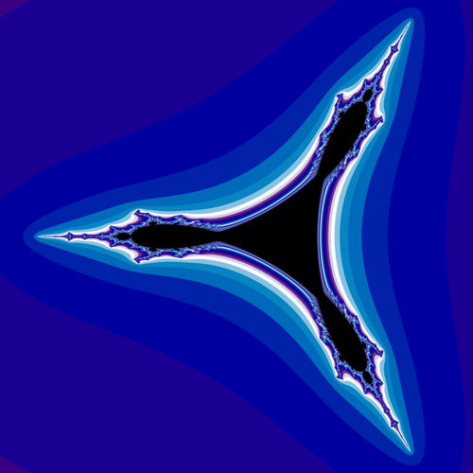
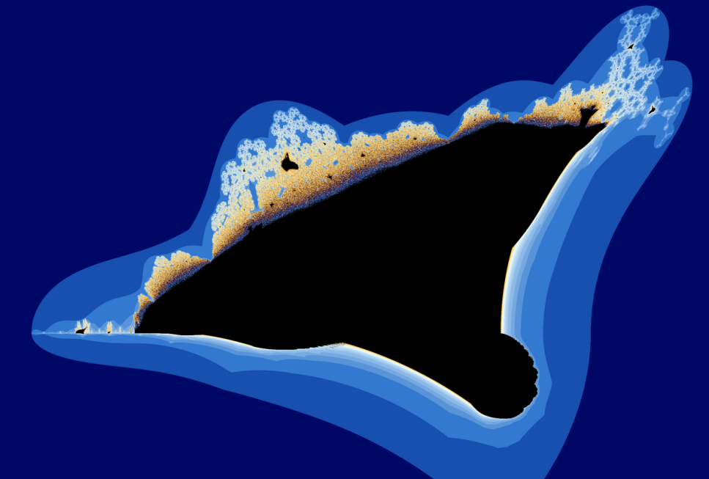
Mandelbrot set
Julia Set
Tricorn Set
Burning Ship Set

Slide 4
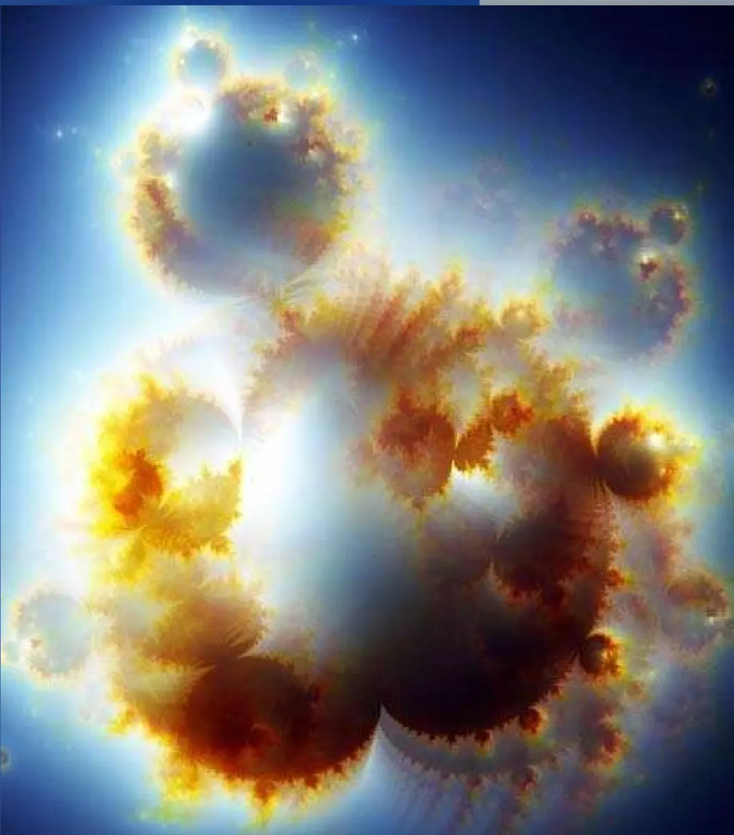
HISTORY OF FRACTALS
Early Mathematical Precursors(1600-1700)
In 1670s Sir Leibniz introduced the concept of recursive patterns.
Birth of Fractal Geometry (Early 1900s)
In this era Sierpiński triangle & carpet set was introduced.
Modern Fractal Geometry
Mandelbrot coins the term Fractal.
Mandelbrot uses IBM computers to plot the Mandelbrot Set.

Slide 5
Project Objectives
Implement Mandelbrot, BurningShip Set , and Tricorn fractal algorithms in C.
Use PBM (Portable Bitmap) format for simple binary (0/1) image output.
Map each pixel to complex plane coordinates.
Apply escape-time algorithm to generate fractal boundaries.
Automate compilation using Makefile.
Generate black & white fractal images without external graphics libraries.
Prepare comprehensive project report, output files, and presentation slides.

Slide 6
Contributions (Members 1 & 2)
Member 1: Dibyendu Das
Introduced the project and assigned responsibilities.
Ensured smooth coordination among teammates.
Helped derive iterative equations.
Worked on project introduction and theory.
Studied about the origin and history of fractals.
Member 2: Piyush Gautam
Helped set up the C programming environment
Ensured compiler, libraries, and code execution worked smoothly
Researched fractal mathematics : Studied complex numbers, escape-time logic, and how fractal equations work
Worked with the <complex.h> library Used functions like cabs() (magnitude), conj() (conjugate)
Worked on the base structure required for all fractal algorithms to run correctly.

Slide 7
Contributions (Members 3 & 4)
Member 3: Divyajeet
Studied about What the Mandelbrot set is.
How the Mandelbrot set is generated.
code a function to determine the particular point is in the set or not.
setting up the iteration limits and boundary conditions so the fractal renders correctly.
Member 4: Rajeev Tirkey
Validated output at different coordinate ranges.
Centered the fractal for better symmetry.
Generated sample mandelbrot.pbm outputs.
mapped each pixel to a corresponding complex coordinate plain using c = x + yi.
Render the output at different scale to ensure smooth repeating structure.

Slide 8
Mandelbrot Set
What is Mandelbrot set?
Set of complex numbers that produces infinite
Repeating structure at different scale.
How the Mandelbrot sets are Generated?
Use of Mandelbrot Equation
Z=Z^2+C
Does Z remains Bounded or escapes to infinity ?

Slide 9
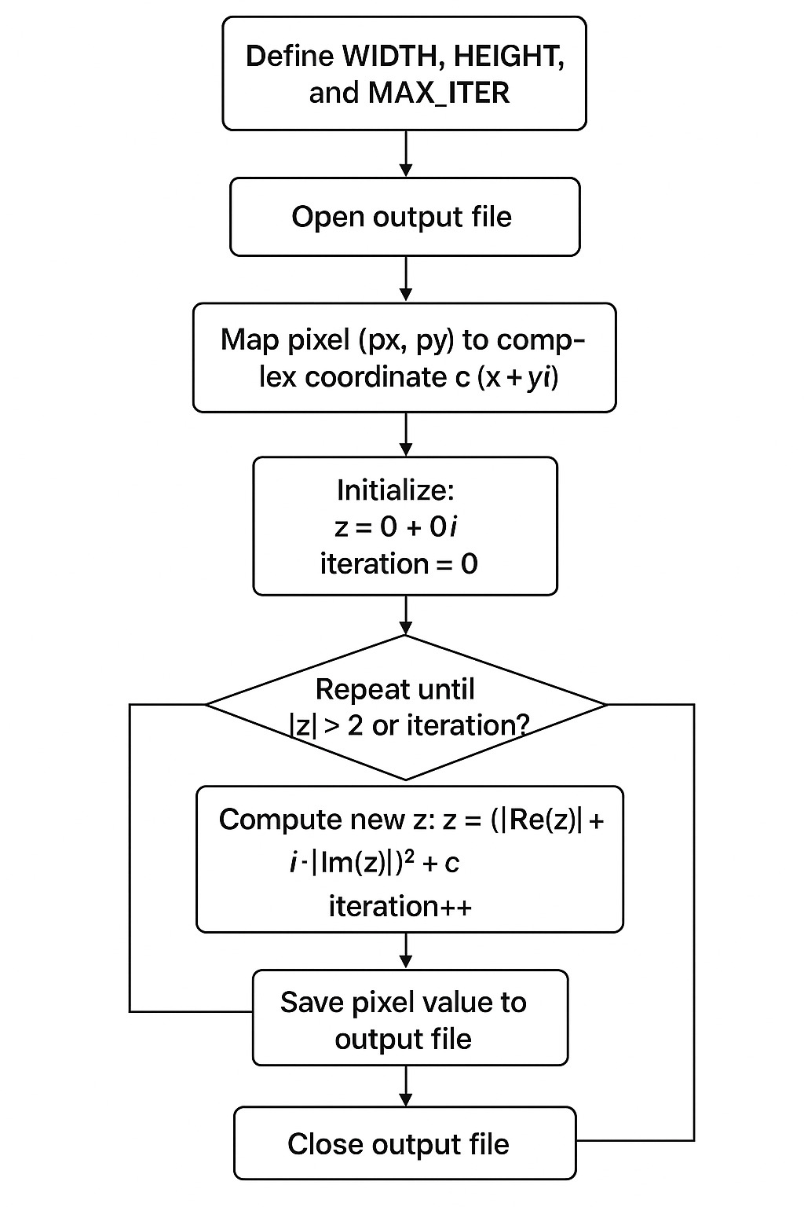
Mandelbrot Set (Algorithm)
Steps:
Initialize parameters — width, height, max iterations.
Loop over each pixel on the screen.
Map pixel to complex coordinate (x + yi).
Apply iteration:
z = z² + c
Assign output 0 or 1 depending on escape status..
Save pixel data to file.

Slide 10

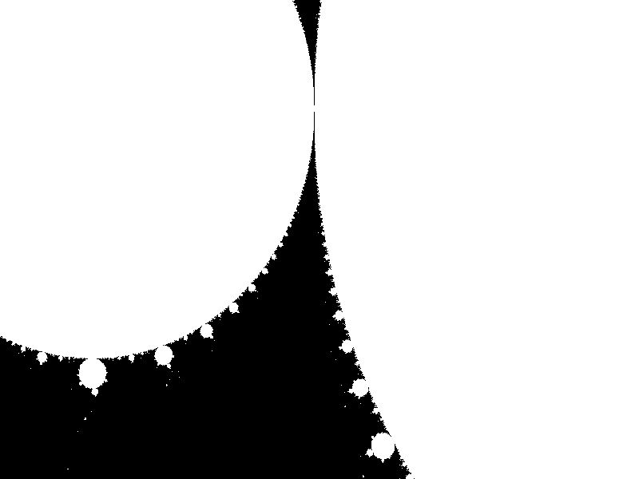
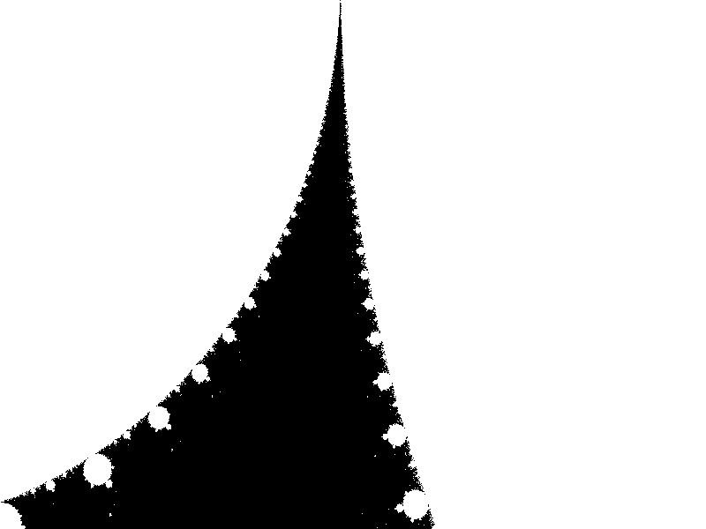
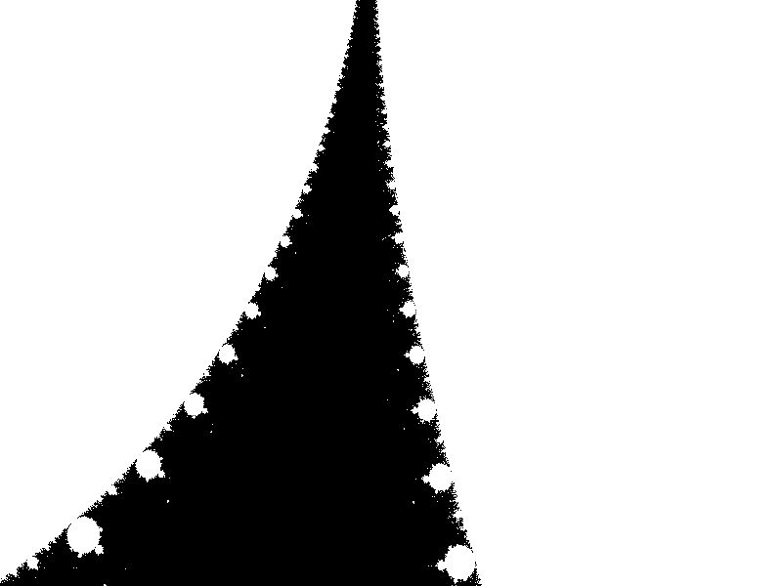
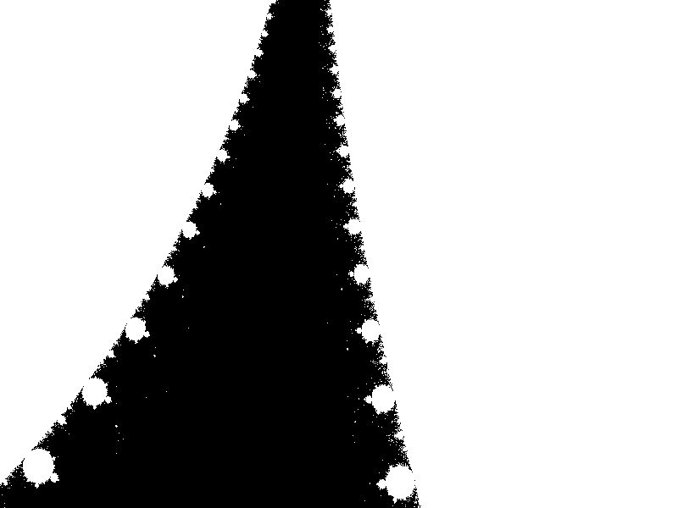
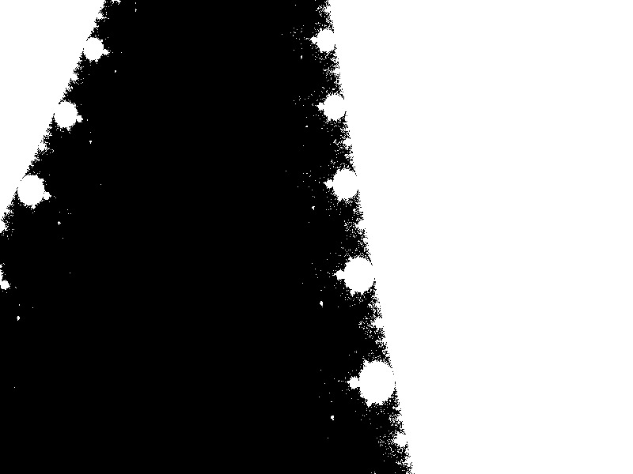

Slide 11

Code Output

Slide 12
Contributions (Members 5 & 6)
Member 5: Smruti Ranjan
Implemented Burning Ship Set algorithm in C.
Worked on applying absolute values fabs(a) and fabs(b) before squaring.
Selected correct coordinate ranges (x_min, x_max, y_min, y_max).
Ensured MAX_ITER = 5000 for detailed spike-like structure.
Member 6: Mohd Sufiyan
Handled output formatting (text-based output using “00” and “11”).
Helped debug pixel mapping and escape condition logic.
Tested and validated the Burning Ship output pattern.
Ensured the fractal displays the characteristic “flame-like” pattern.

Slide 13

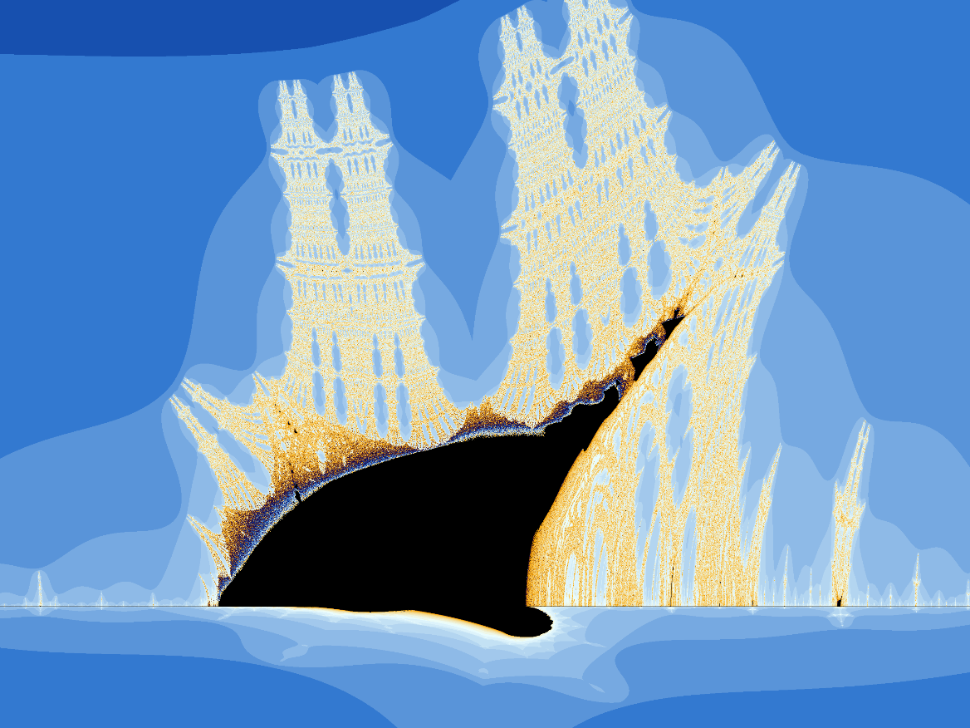

The Burning Ship fractal, first described and created by Michael Michelitsch and Otto E. Rössler in 1992, is generated by iterating the function:
𝑧𝑛+1=(|𝑅𝑒(𝑧𝑛)|+𝑖|𝐼𝑚(𝑧𝑛)|)2+𝑐

Slide 14
Burningship Set (Algorithm)
Steps:
Initialize parameters — width, height, max iterations.
Loop over each pixel on the screen.
Map pixel to complex coordinate (x + yi).
Apply iteration:
z = (|Re(z)| + i·|Im(z)|)² + c.
Assign output 0 or 1 depending on escape status..
Save pixel data to file.

Slide 15

Code Output

Slide 16
Contributions (Members 7 & 8)
Member 7: Manish Kumar
Implemented tricorn_set.c.
Used anti-holomorphic iteration:
z = conj(z)^2 + c.
Researched Tricorn’s three-fold symmetry.
Member 8: Sumit Raj Chaudhary
Compared the visual differences between all fractal types.
Generated PBM images for testing and documentation. PBM is a simple black-and-white image format that uses only 0 and 1 to represent pixels.
Organized and integrated all output files into the final project folder.

Slide 17
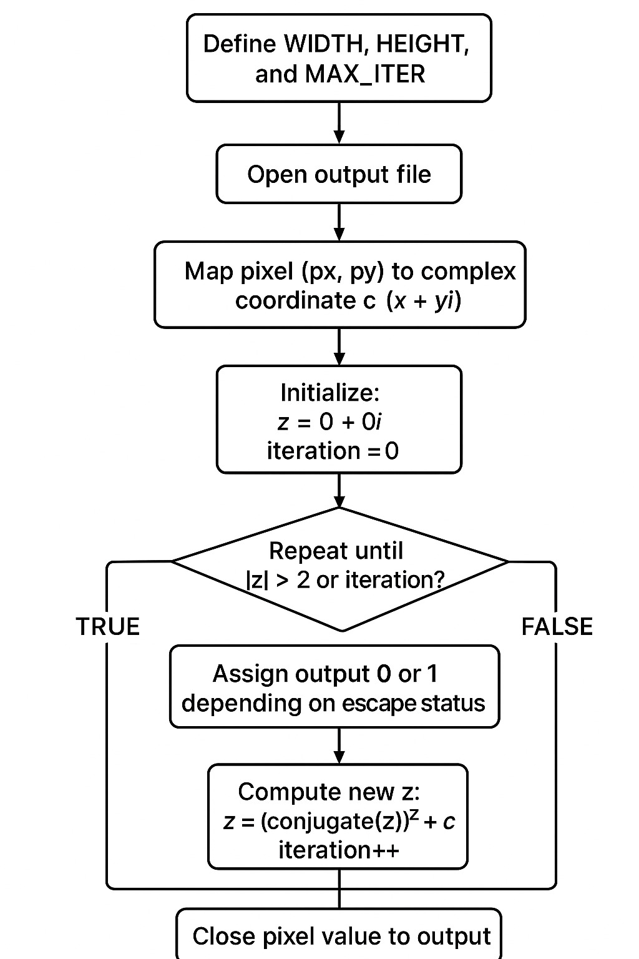
Tricorn Set (Algorithm)
Steps:
Initialize parameters — width, height, max iterations.
Loop over each pixel on the screen.
Map pixel to complex coordinate (x + yi).
Apply iteration:
z = conj(z²) + c
Assign output 0 or 1 depending on escape status..
Save pixel data to file.

Slide 18
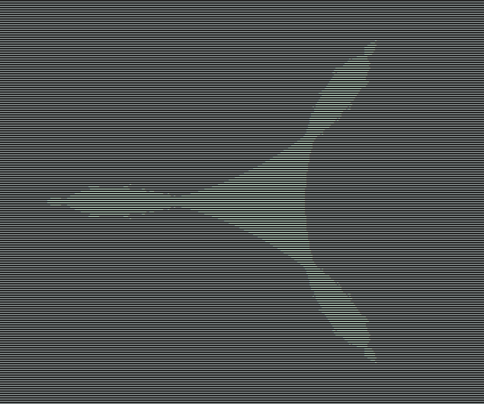
Code Output

Slide 19
Contributions (Members 9 & 10)
Member 9: Shri Krishan
Created Makefile for automating compilation.
Created a file structure to automate the execution.
Main.c
Mandelbrot.c
Burningship.c
Tricorn.c
Ensured smooth compilation of all three fractals.
Member 10: Rajdeep Gupta
Worked on optimization and code cleanup.
Performed debugging for segmentation faults & slow runs.
Prepared sample images for PPT/report.

Slide 20
Contributions (Members 11 & 12)
Member 11: Jitendra Singh
Wrote major sections of project report (methodology, results).
Collected screenshots and outputs.
Helped in final formatting.
Member 12: Amit Singhad
Organized the content properly for the presentation.
Designed clean and simple slides for better understanding.
Added a flowchart to show the step-by-step fractal generation process.
Inserted GIF animations to explain fractal zooming and self-similarity.
Included outputs of Mandelbrot, Tricorn, and Burning Ship fractals

Slide 21
Conclusion & Future Work
Conclusion:
Implemented fractal generation using C and PBM format.
Understood complex numbers, iteration, and escape-time logic.
Automated workflows using Makefile.
Achieved clean black & white fractal outputs.
Future Scope:
Add grayscale (PGM) and color (PPM) visualization.
Implement zooming and panning.
Convert PBM into video animations.
GPU-based fractal rendering for real-time performance.

Slide 22
BurningShip Set
Mandelbrot Set
Trion Set

Slide 23
THANK YOU

